Slide 1
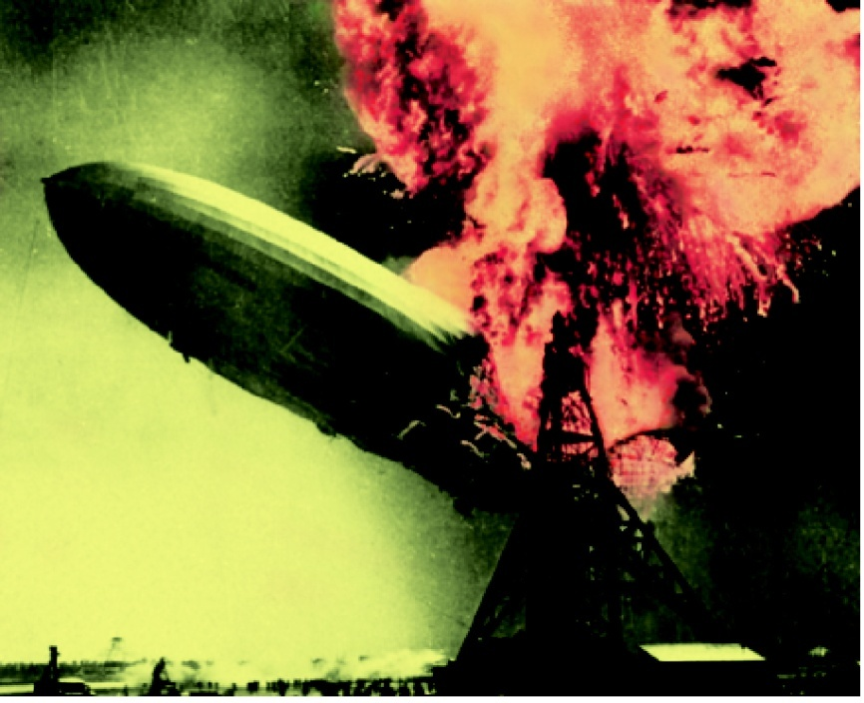
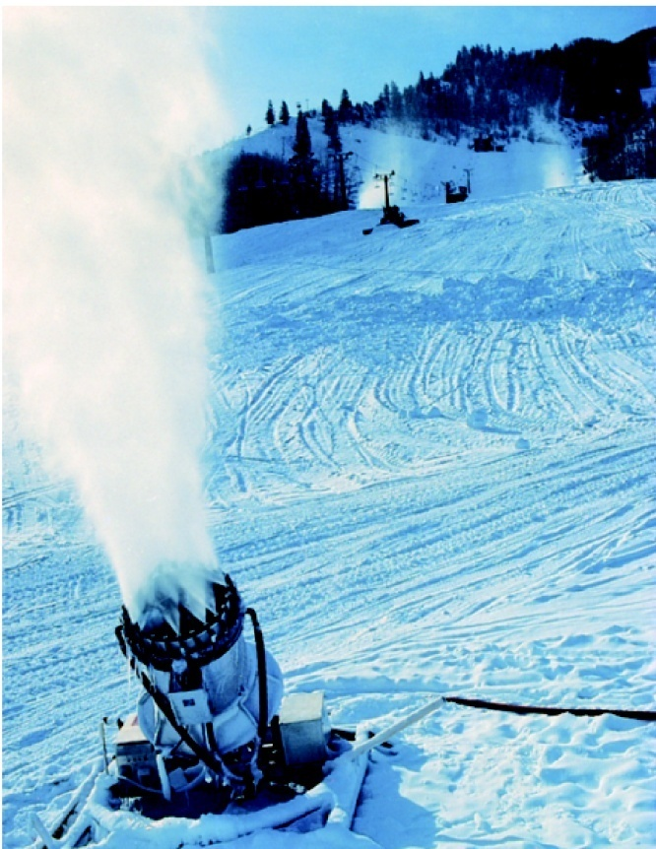
Thermochemistry
Chapter 6
Copyright © The McGraw-Hill Companies, Inc. Permission required for reproduction or display.

Slide 2
Energy is the capacity to do work.
Thermal energy is the heat energy associated with the random motion of atoms and molecules.

Slide 3
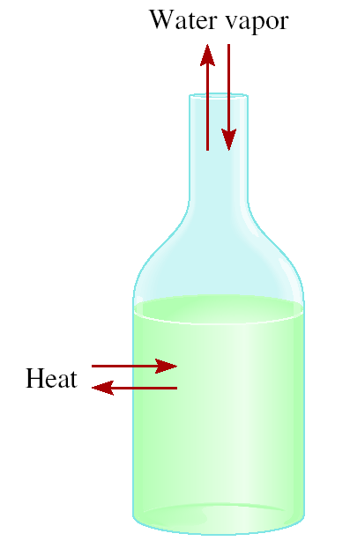
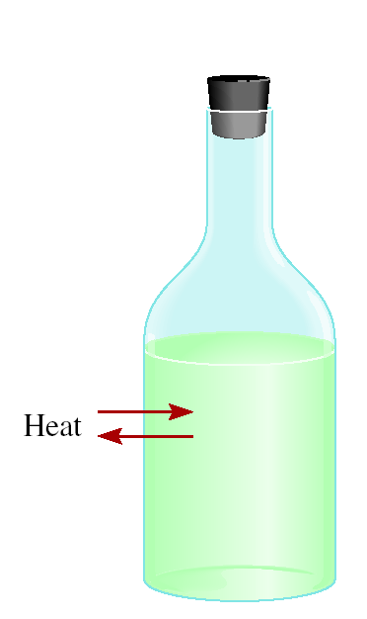
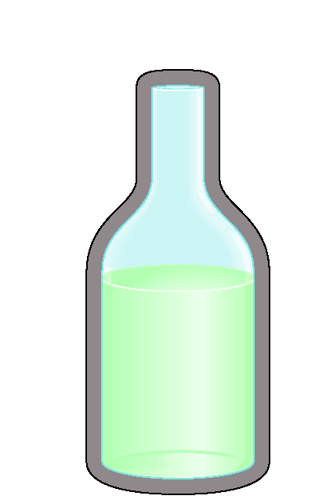
Thermochemistry is the study of heat change in chemical reactions.
The system is the specific part of the universe that is of interest in the study.
The surroundings are the rest of the universe outside the system.
Three types of systems
open
closed
isolated
Exchange:
mass & energy
energy
nothing

Slide 4
Exothermic and Endothermic Processes
Exothermic process is any process that gives off heat – transfers thermal energy from the system to the surroundings.
2H₂ (g) + O₂ (g) 2H₂O (l) + energy
H₂O (g) H₂O (l) + energy
Endothermic process is any process in which heat has to be supplied to the system from the surroundings.
energy + 2HgO (s) 2Hg (l) + O₂ (g)
energy + H₂O (s) H₂O (l)

Slide 5
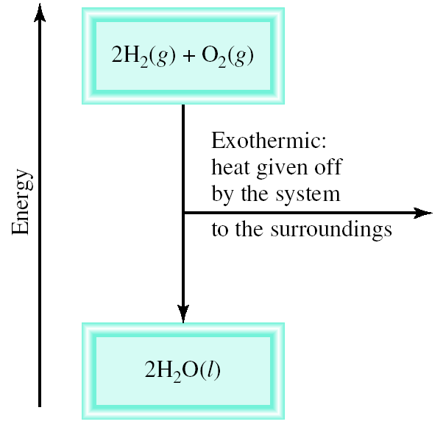
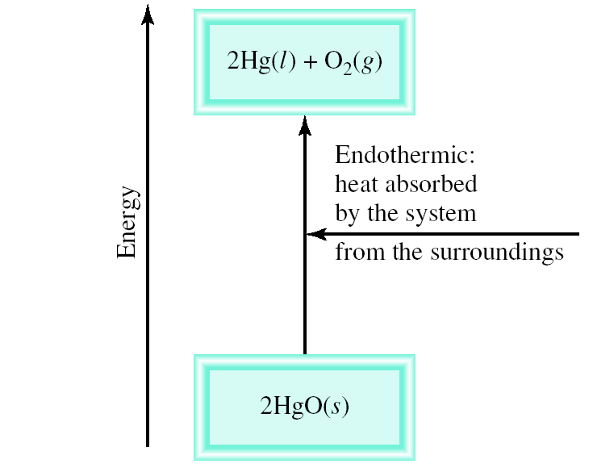
Schematic of Exothermic and Endothermic Processes

Slide 6
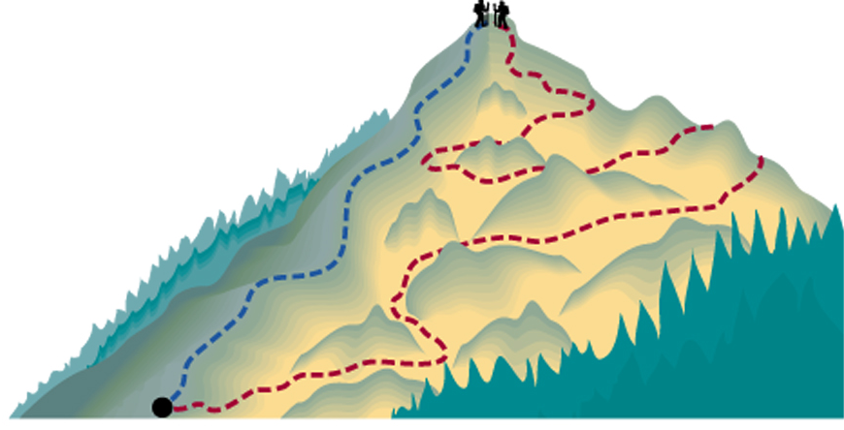
Thermodynamics is the scientific study of the interconversion of heat and other kinds of energy.
State functions are properties that are determined by the state of the system, regardless of how that condition was achieved.
energy
, pressure, volume, temperature
ΔE = E_{final} - E_{initial}
ΔP = P_{final} - P_{initial}
ΔV = V_{final} - V_{initial}
ΔT = T_{final} - T_{initial}
Potential energy of hiker 1 and hiker 2 is the same even though they took different paths.

Slide 7
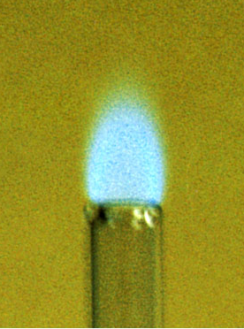
First law of thermodynamics – energy can be converted from one form to another, but cannot be created or destroyed.
ΔE_{system} + ΔE_{surroundings} = 0
or
ΔE_{system} = -ΔE_{surroundings}
C₃H₈ + 5O₂ 3CO₂ + 4H₂O
Exothermic chemical reaction!
Chemical energy lost by combustion = Energy gained by the surroundings
system
surroundings

Slide 8
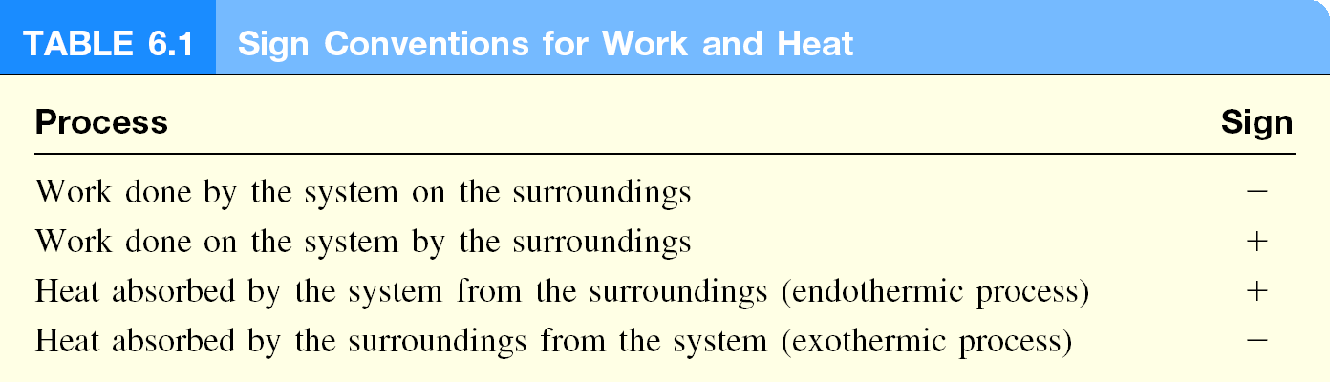
Another form of the first law for ΔE_{system}
ΔE = q + w
ΔE is the change in internal energy of a system
q is the heat exchange between the system and the surroundings
w is the work done on (or by) the system
w = -PΔV when a gas expands against a constant external pressure

Slide 9
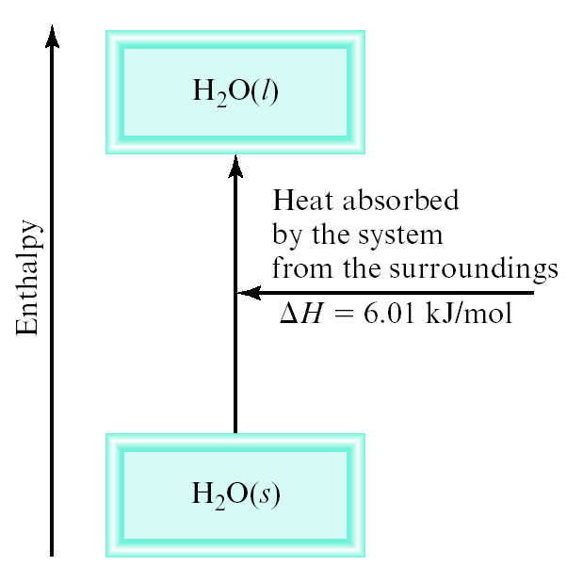
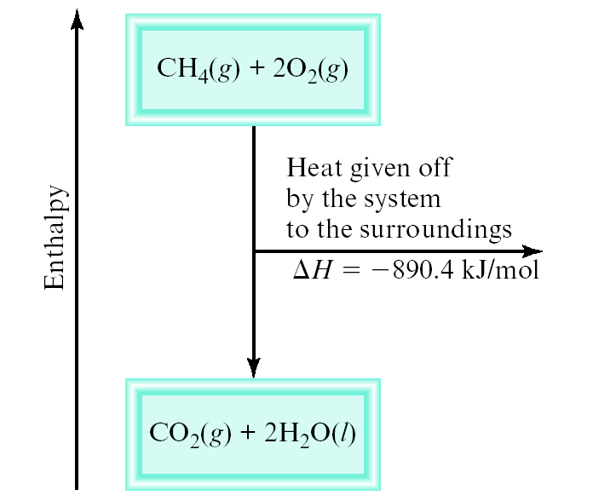
Enthalpy (H) is used to quantify the heat flow into or out of a system in a process that occurs at constant pressure.
ΔH = H (products) – H (reactants)
ΔH = heat given off or absorbed during a reaction at constant pressure
H_{products} > H_{reactants}
H_{products} < H_{reactants}
ΔH > 0
ΔH < 0

Slide 10

Thermochemical Equations
Is ΔH negative or positive?
System absorbs heat
Endothermic
ΔH > 0
6.01 kJ are absorbed for every 1 mole of ice that melts at 0⁰C and 1 atm.
H₂O (s) H₂O (l)
ΔH = 6.01 kJ/mol

Slide 11

Thermochemical Equations
Is ΔH negative or positive?
System gives off heat
Exothermic
ΔH < 0
890.4 kJ are released for every 1 mole of methane that is combusted at 25⁰C and 1 atm.
CH₄ (g) + 2O₂ (g) CO₂ (g) + 2H₂O (l)
ΔH = -890.4 kJ/mol

Slide 12
Thermochemical Equations
The stoichiometric coefficients always refer to the number of moles of a substance:
H₂O (s) H₂O (l)
ΔH = 6.01 kJ/mol
If you reverse a reaction, the sign of ΔH changes:
H₂O (l) H₂O (s)
ΔH = -6.01 kJ/mol
If you multiply both sides of the equation by a factor n, then ΔH must change by the same factor n:
2H₂O (s) 2H₂O (l)
ΔH = 2 x 6.01 = 12.0 kJ

Slide 13
Thermochemical Equations
The physical states of all reactants and products must be specified in thermochemical equations.
H₂O (s) H₂O (l)
ΔH = 6.01 kJ/mol
H₂O (l) H₂O (g)
ΔH = 44.0 kJ/mol
How much heat is evolved when 266 g of white phosphorus (P₄) burn in air?
P₄ (s) + 5O₂ (g) P₄O₁₀ (s) ΔH = -3013 kJ/mol
1 mol P₄
-3013 kJ
266 g P₄
x
x
= -6470 kJ
123.9 g P₄
1 mol P₄

Slide 14
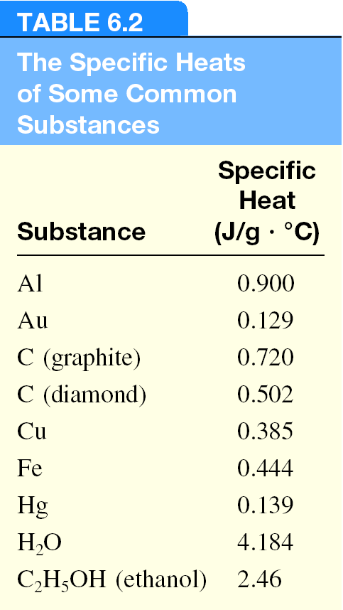
Specific Heat & Heat Capacity
The specific heat (s) of a substance is the amount of heat (q) required to raise the temperature of one gram of the substance by one degree Celsius.
The heat capacity (C) of a substance is the amount of heat (q) required to raise the temperature of a given quantity (m) of the substance by one degree Celsius.
C = m x s
Heat (q) absorbed or released:
q = m x s x Δt
q = C x Δt
Δt = t_{final} - t_{initial}

Slide 15
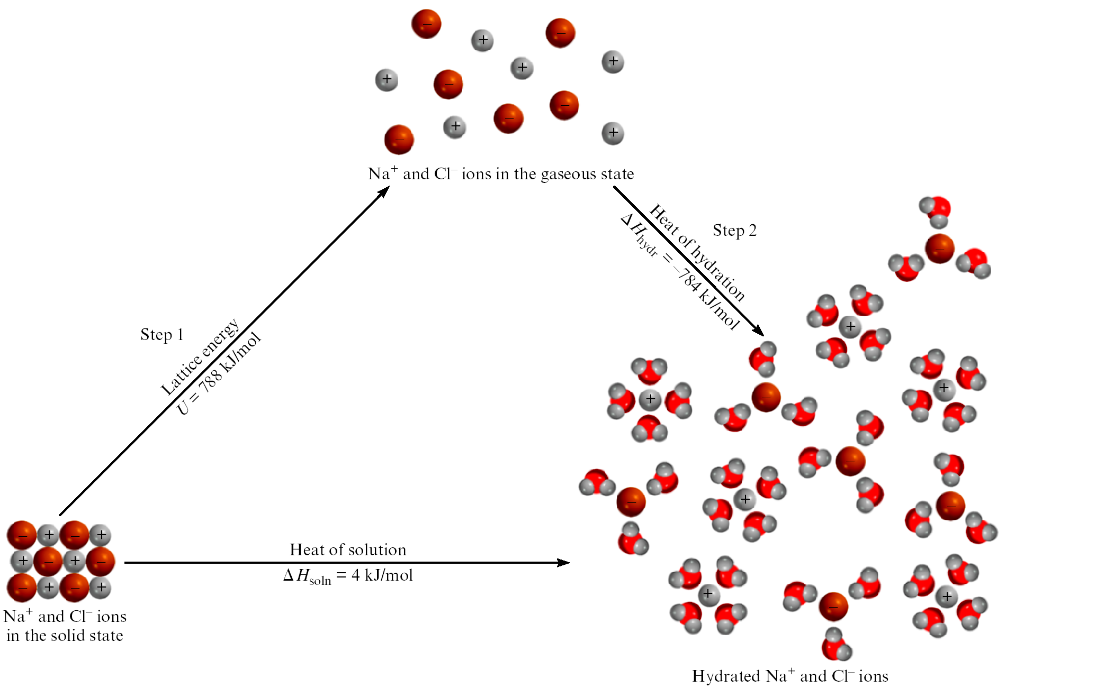
The Solution Process for NaCl
ΔH_{soln} = Step 1 + Step 2 = 788 – 784 = 4 kJ/mol

Slide 16
Energy Diagram
Energy
Progress of reaction
Notes:
16

Slide 17
Energy Diagram (Exothermic)
Energy
Progress of reaction
Notes:
17

Slide 18
Energy Diagram (Exothermic)
Reactants
Energy
Progress of reaction
Notes:
18

Slide 19
Energy Diagram (Exothermic)
Reactants
Energy
Collision zone
Progress of reaction
Notes:
19

Slide 20
Energy Diagram (Exothermic)
Reactants
Energy
Collision zone
Products
Progress of reaction
Notes:
20

Slide 21
Collision Zone Events
Let’s track the events that transpire as a reaction actually occurs
This detailed information is available in the Collision Zone part of our energy diagram...
Notes:
21

Slide 22
Energy Diagram (Exothermic)
A reaction is about to occur
Reactants
Energy
Collision zone
Products
Progress of reaction
Notes:
22

Slide 23
Energy Diagram (Exothermic)
Reactant species electron clouds make contact
Reactants
Energy
Collision zone
Products
Progress of reaction
Notes:
23

Slide 24
Energy Diagram (Exothermic)
Reaction begins as electron clouds make contact
Reactants
Energy
Collision zone
Products
Progress of reaction
Notes:
24

Slide 25
Energy Diagram (Exothermic)
Reactant species electron clouds make contact
Reactants
Energy
Collision zone
Products
Progress of reaction
Notes:
25

Slide 26
Energy Diagram (Exothermic)
Transition state (or activated complex) - maximum compression during collision
Reactants
Energy
Collision zone
Products
Progress of reaction
Notes:
26

Slide 27
Energy Diagram (Exothermic)
Reactant species electron clouds make contact
Reactants
Energy
Collision zone
Products
Progress of reaction
Notes:
27

Slide 28
Energy Diagram (Exothermic)
A rearrangement has occurred! Product molecules recoil.
Reactants
Energy
Collision zone
Products
Progress of reaction
Notes:
28

Slide 29
Energy Diagram (Exothermic)
Reactant species electron clouds make contact
Reactants
Energy
Collision zone
Products
Progress of reaction
Notes:
29

Slide 30
Energy Diagram (Exothermic)
Contact lost. Our molecules go on with their new lives
Reactants
Energy
Collision zone
Products
Progress of reaction
Notes:
30

Slide 31
Energy Diagram (Exothermic)
Reactant species electron clouds make contact
Reactants
Energy
Collision zone
Products
Progress of reaction
Notes:
31

Slide 32
Collision Zone Events
We’ll watch the movie frames again, without the distracting commentary
That way we can appreciate the fluid grace of a perfect reaction collision!!!
(Laying in on pretty thick, eh?)
Notes:
32

Slide 33
Energy Diagram (Exothermic)
Reactant species electron clouds make contact
Reactants
Energy
Collision zone
Products
Progress of reaction
Notes:
33

Slide 34
Energy Diagram (Exothermic)
Reactant species electron clouds make contact
Reactants
Energy
Collision zone
Products
Progress of reaction
Notes:
34

Slide 35
Energy Diagram (Exothermic)
Reactant species electron clouds make contact
Reactants
Energy
Collision zone
Products
Progress of reaction
Notes:
35

Slide 36
Energy Diagram (Exothermic)
Reactant species electron clouds make contact
Reactants
Energy
Collision zone
Products
Progress of reaction
Notes:
36

Slide 37
Energy Diagram (Exothermic)
Reactant species electron clouds make contact
Reactants
Energy
Collision zone
Products
Progress of reaction
Notes:
37

Slide 38
Activation Energy
The height of the transition state (or activated complex) above the starting energy of the reactants is known as the activation energy
Notes:
38

Slide 39
Energy Diagram (Exothermic)
Reactants
Energy
Products
Progress of reaction
Notes:
39

Slide 40
Energy Diagram (Exothermic)
Activation energy
Reactants
Energy
Products
Progress of reaction
Notes:
40

Slide 41
Energy Diagram (Exothermic)
E_{act}
Reactants
Energy
Products
Progress of reaction
Notes:
41

Slide 42
Energy Diagram (Exothermic)
ΔH
Reactants
Energy
Products
Progress of reaction
Notes:
42

Slide 43
Activation Energy
The size of the activation energy barrier determines how easy it is to initiate a reaction
A high barrier is associated with a difficult reaction to start
A low barrier is associated with an easy, “hair-trigger” reaction
Notes:
43

Slide 44
Energy Diagram (Exothermic)
Activation energy
Relatively high barrier
Energy
Progress of reaction
Notes:
44

Slide 45
Energy Diagram (Exothermic)
Activation energy
Relatively low barrier
Energy
Progress of reaction
Notes:
45

Slide 46
Heat of Reaction
The thermodynamics of the reaction can also be viewed on energy diagrams
Focus on the difference in energy level between reactants and products
This corresponds to the heat of reaction, ΔH_{rxn}!
Notes:
46

Slide 47
Energy Diagram (Exothermic)
Reactants
Energy
Products
Progress of reaction
Notes:
47

Slide 48
Energy Diagram (Exothermic)
Reactants
Energy
Heat of reaction
Products
Progress of reaction
Notes:
48

Slide 49
Energy Diagram (Exothermic)
Reactants
Energy
ΔH_{rxn}
Products
Progress of reaction
Notes:
49

Slide 50
Energy Diagram (Exothermic)
If the products contain less energy than the reactants, an exothermic reaction has occurred
Reactants
Energy
ΔH_{rxn}
Products
Progress of reaction
Notes:
50

Slide 51
Energy Diagram (Exothermic)
The missing energy has been released to the surrounding environment. ΔH would show a negative value
Reactants
Energy
ΔH_{rxn}
Products
Progress of reaction
Notes:
51

Slide 52
Energy Diagram (Exothermic)
Transition state
Activation energy
Energy
Progress of reaction
Notes:
52

Slide 53
Energy Diagram (Exothermic)
Transition state
Reactants
Energy
Heat of reaction
Products
Progress of reaction
Notes:
53

Slide 54
Energy Diagram (Endothermic)
An endothermic reaction leads to products that contain more energy than the reactants started with
Energy has been stored as chemical potential energy
These would show a positive ΔH_{rxn}
Notes:
54

Slide 55
Energy Diagram (Endothermic)
Products
Energy
Heat of reaction
Reactants
Progress of reaction
Notes:
55

Slide 56
Energy Diagram (Endothermic)
If the products contain more energy than the reactants, an endothermic reaction has occurred
Products
Energy
Heat of reaction
Reactants
Progress of reaction
Notes:
56

Slide 57
Energy Diagram (Endothermic)
The added energy is stored in the chemical bonds of the products. ΔH would show a positive value
Products
Energy
Heat of reaction
Reactants
Progress of reaction
Notes:
57

Slide 58
Energy Diagram (Endothermic)
Products
Energy
What’s this?
Reactants
Progress of reaction
Notes:
58

Slide 59
Energy Diagram (Endothermic)
Products
Energy
E_{act}
Reactants
Progress of reaction
Notes:
59

